Slide 1
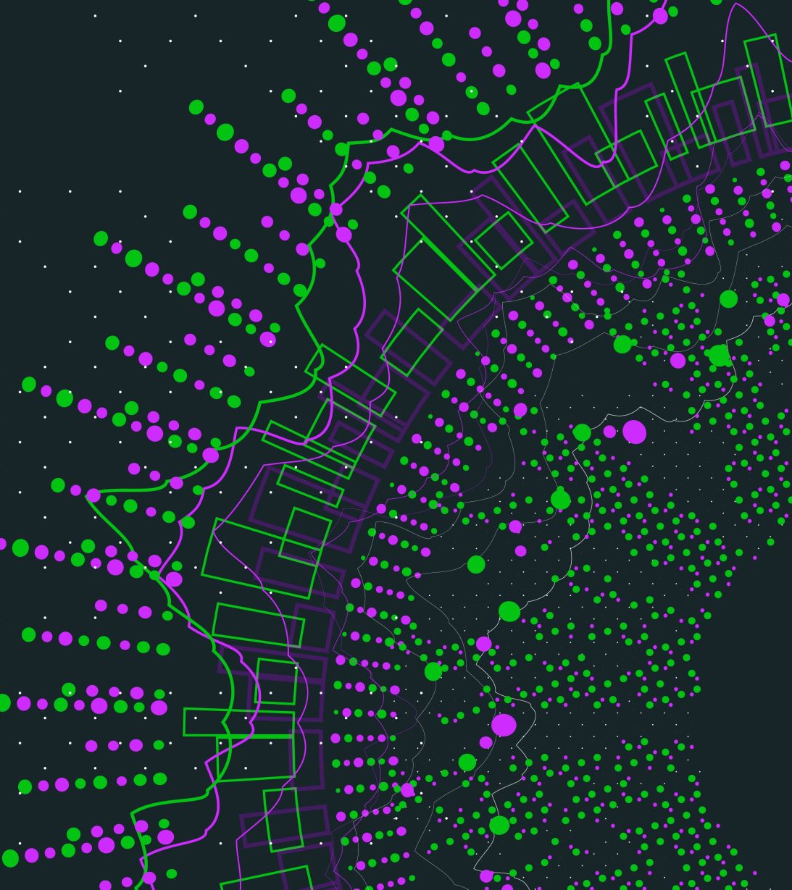
Applied Machine Learning with Onnx Runtime
Jen Looper
Principal Cloud Advocate, Microsoft

Slide 2
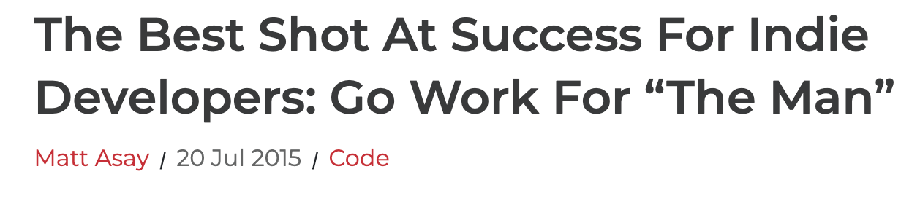
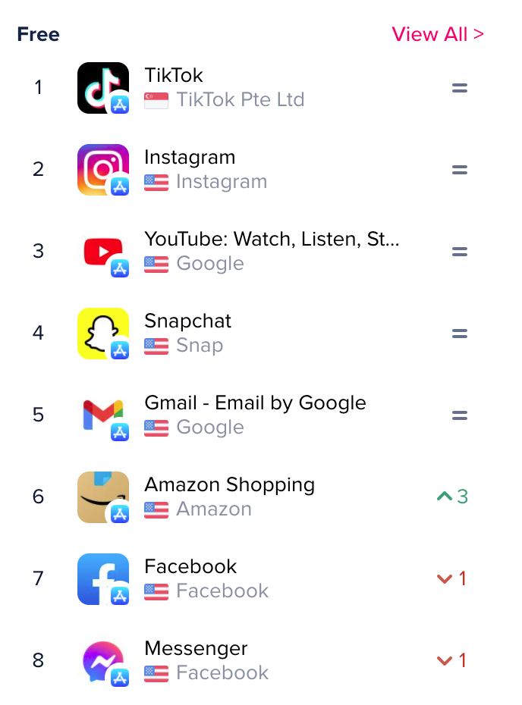
Smart apps
Apps are now infused with intelligence
”Intelligent-first”
Theory: death of the indie has to do in part with this complexity

Slide 3
If you were build a new ‘smart’ app...
How would you build it?
What architectural decisions would guide you?
What technical stack would you use?
For web?
For mobile?
For a hybrid (both/and) app experience?
On desktop?

Slide 4
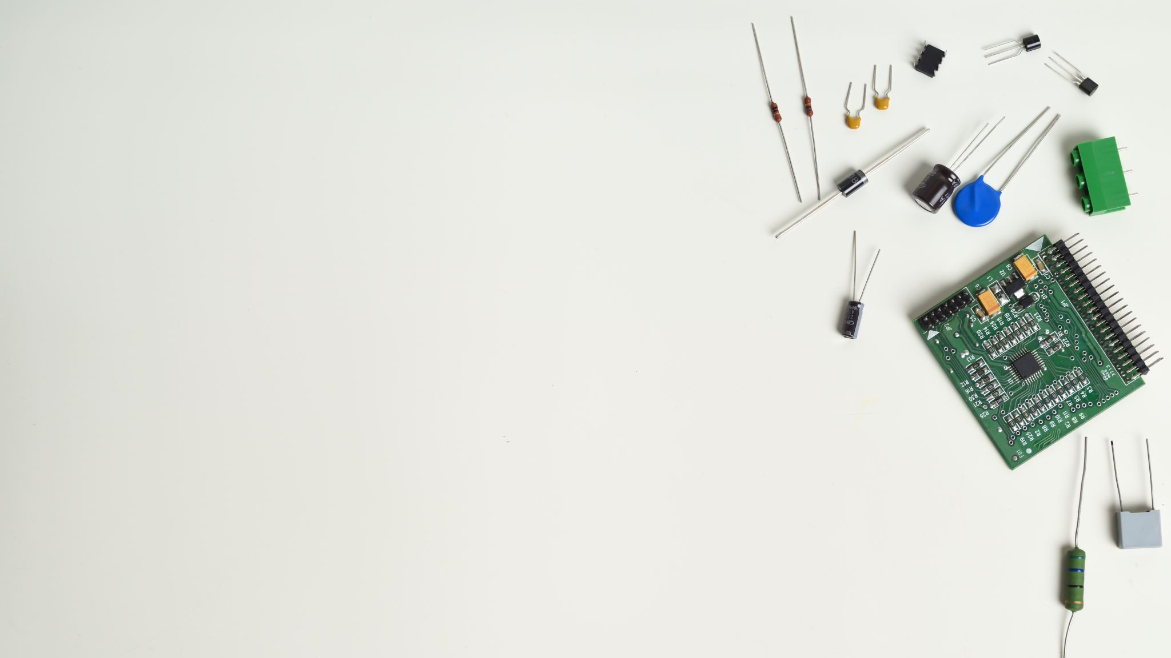
Problem
Web Developers and ML Engineers have completely different skills sets

Slide 5
Web Developers
ML Engineers
Work with backend engineers, DevOps, designers, accessibility experts to create a great user-facing web site
Work with Data Scientists to source, clean, prepare, and train data, iterating until an accurate ML model can be created and exported

Slide 6

Can we bridge this divide?

Slide 7



Welcome to Applied ML
Tools to ease the way
TensorFlow
Brain.js
Onnx

Slide 8
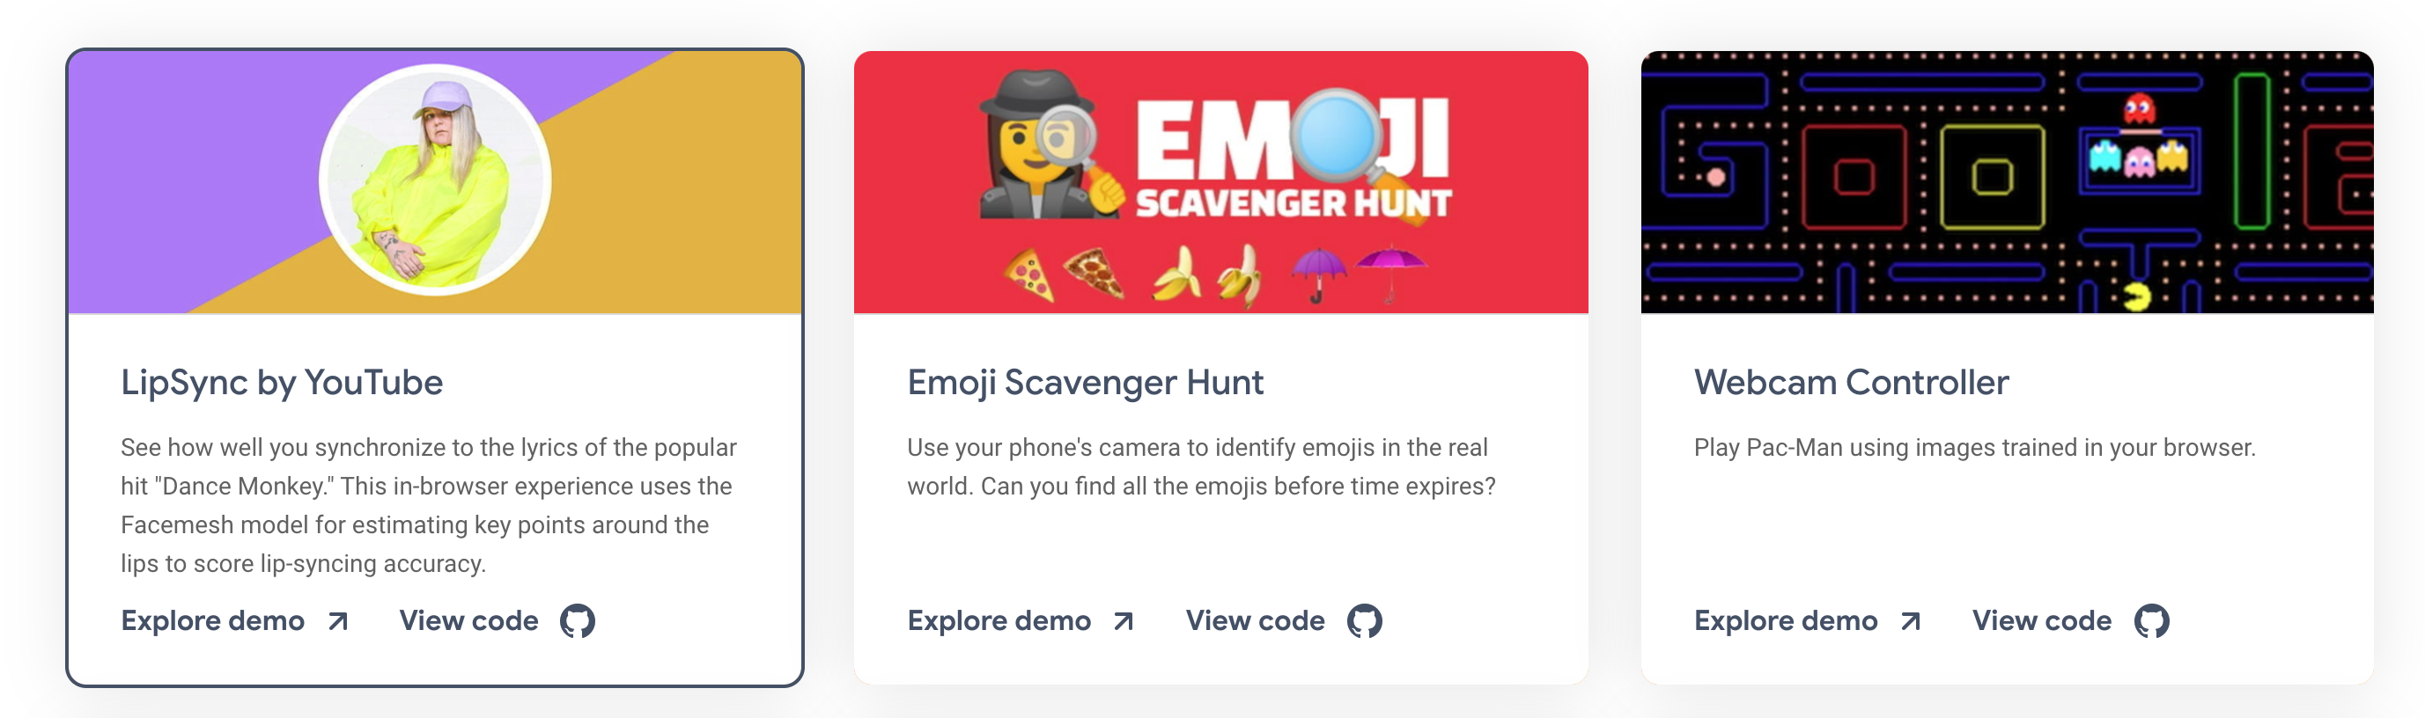
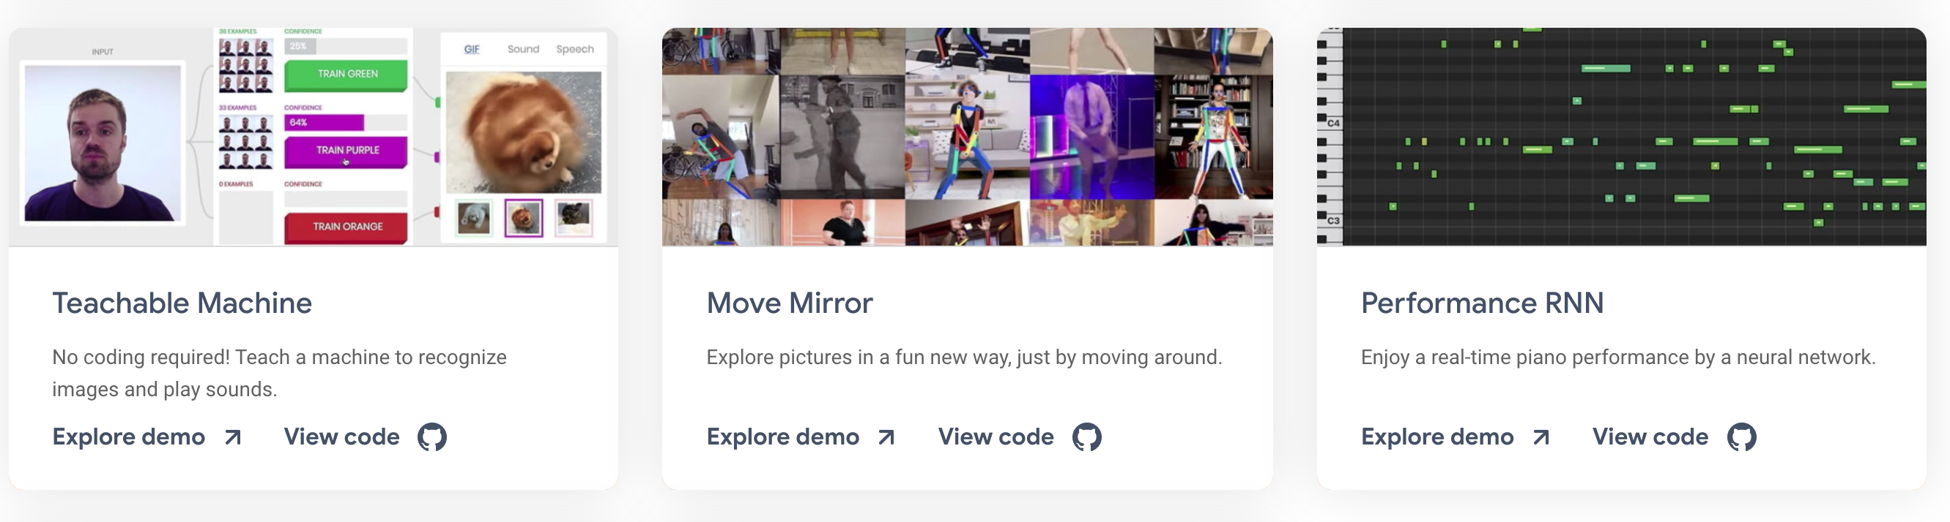
TensorFlow.js
Big ecosystem, lots of excitement!
Cool integrations
Training and inference occur in the browser
or
Use pretrained-models for transfer learning

Slide 9
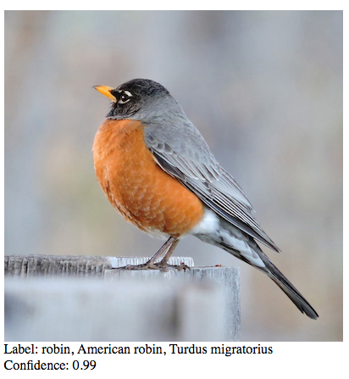
Try ML5.js
“ml5.js is machine learning for the web in your web browser. Through some clever and exciting advancements, the folks building TensorFlow.js figured out that it is possible to use the web browser's built in graphics processing unit (GPU) to do calculations”
Image recognition
Sound analysis
Text analysis

Slide 10
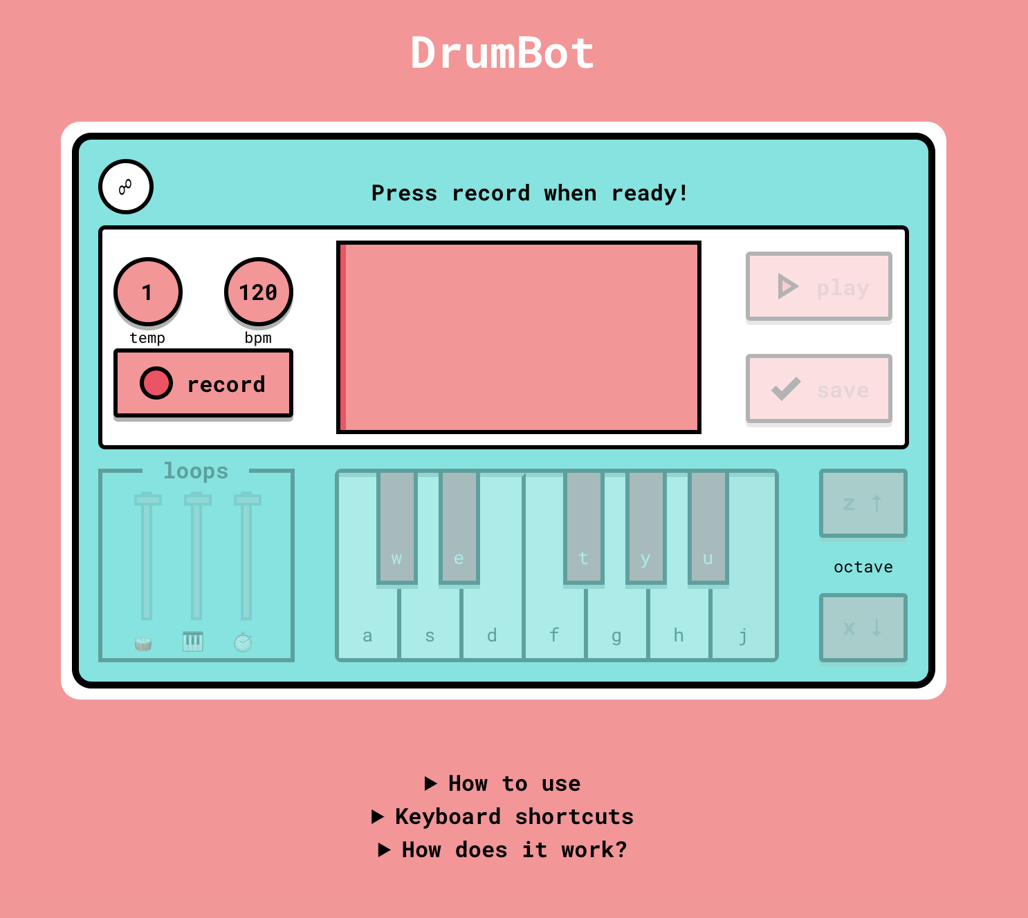
Try Magenta.js
“Make music and art in the browser. Magenta.js is an open source JavaScript API for using the pre-trained Magenta models in the browser. It is built with TensorFlow.js, which allows for fast, GPU-accelerated inference. ”
All about sound and art

Slide 11
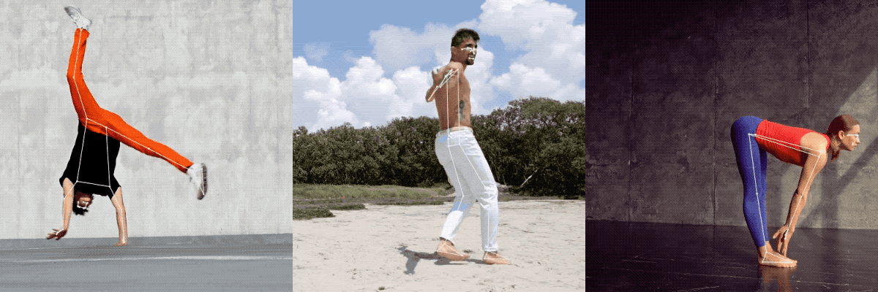
Try PoseNet
“PoseNet can be used to estimate either a single pose or multiple poses…in an image/video.”
All about how the body works

Slide 12
Try Brain.js
“GPU accelerated Neural networks in JavaScript
for Browsers and Node.js”
If you need a neural network to run in the browser, try brain.js.
For images, text, forecasting, and more

Slide 13
Q: should you train data in the browser?
A: Probably not, if you are making anything production-grade!

Slide 14
Idea: train using TF (Python) and convert to use with the web
tensorflowjs_converter \ --input_format=tf_saved_model \ --output_format=tfjs_graph_model \ --signature_name=serving_default \ --saved_model_tags=serve \ /mobilenet/saved_model \ /mobilenet/web_model

Slide 15

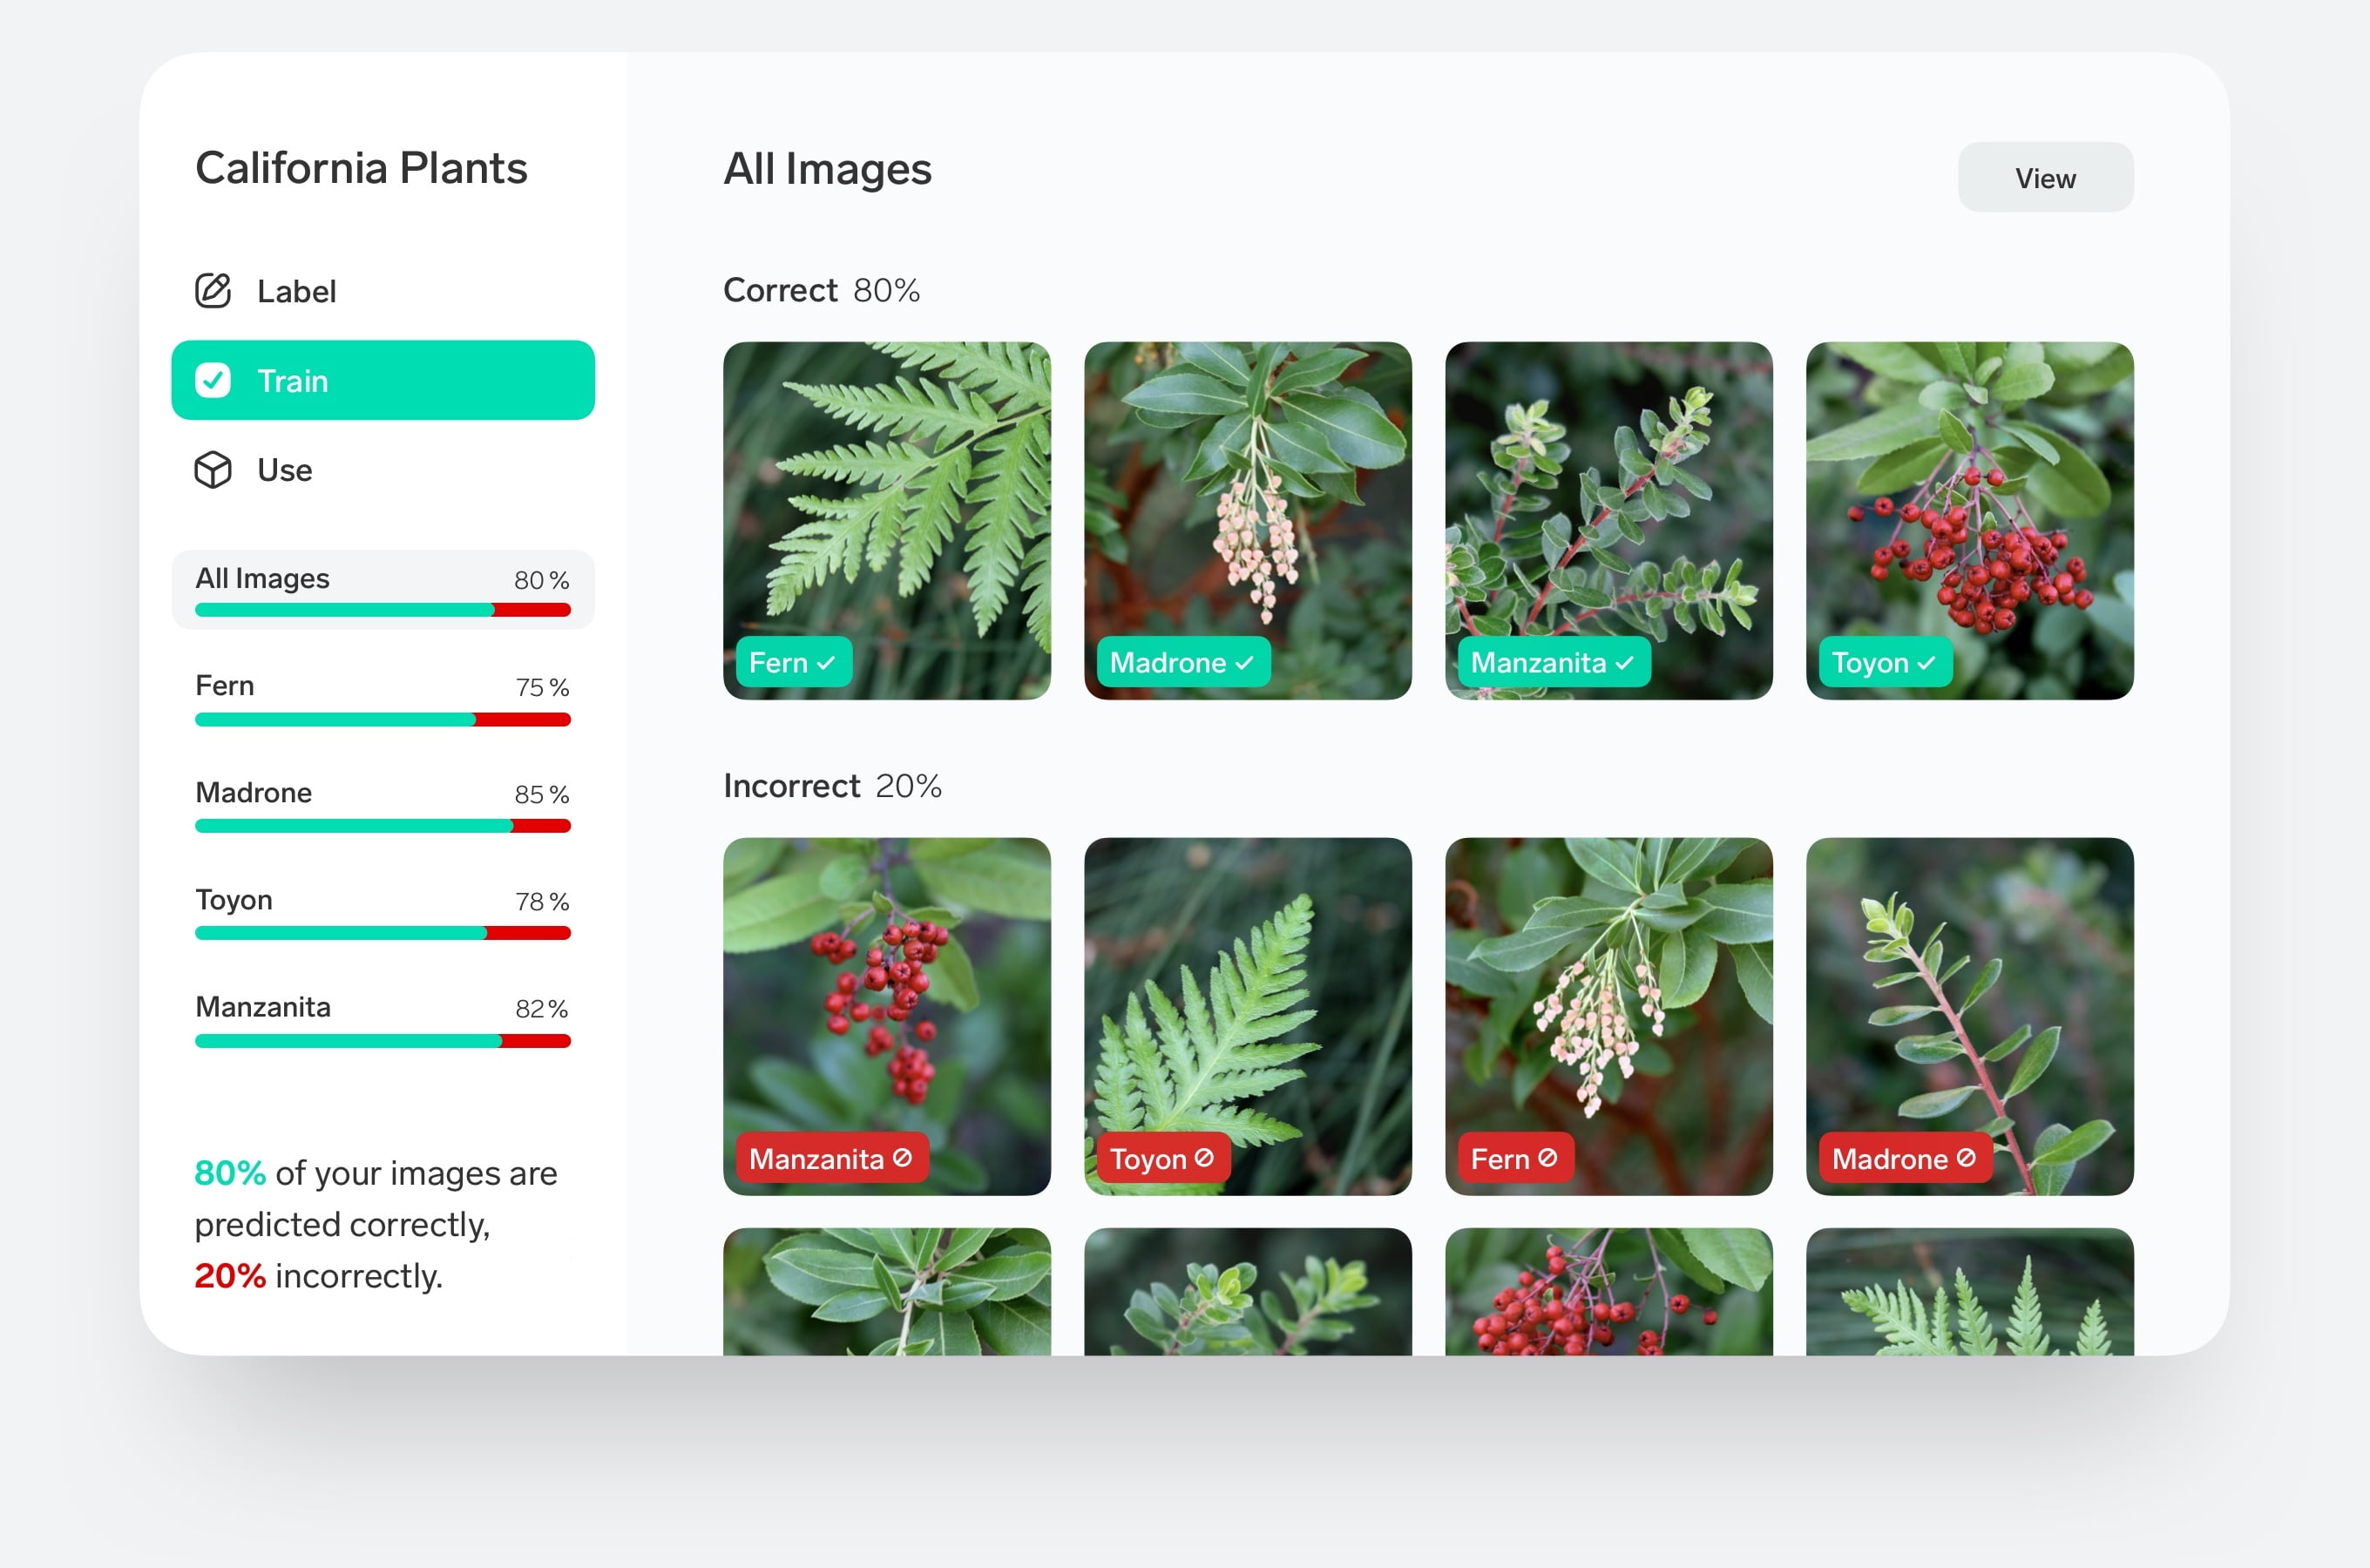
Idea: train data with external tools and convert for use on the web
A small demo of Lobe.ai

Slide 16
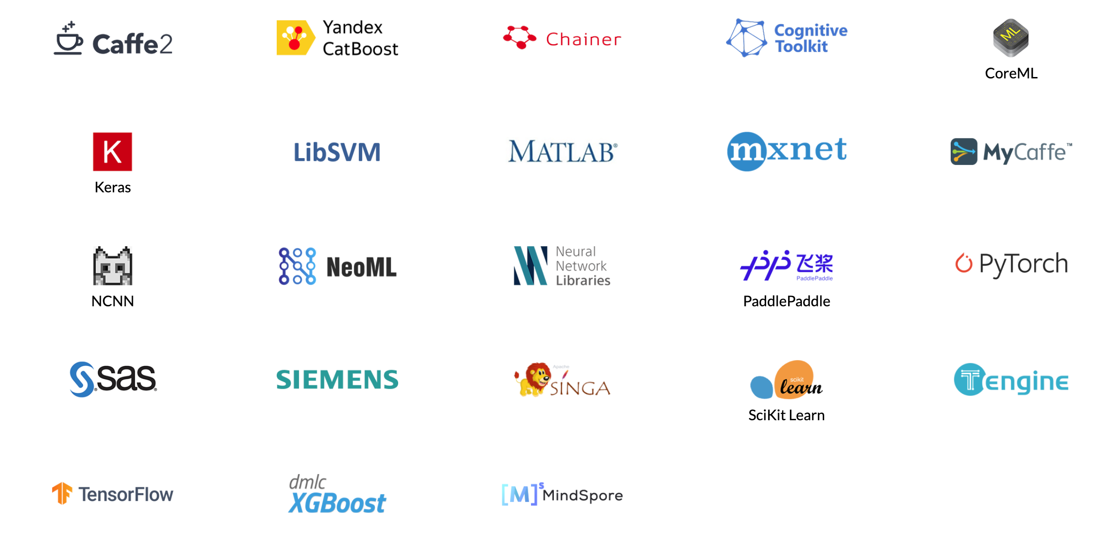
Q: what if you don’t want to exclusively use TensorFlow?
😱

Slide 17
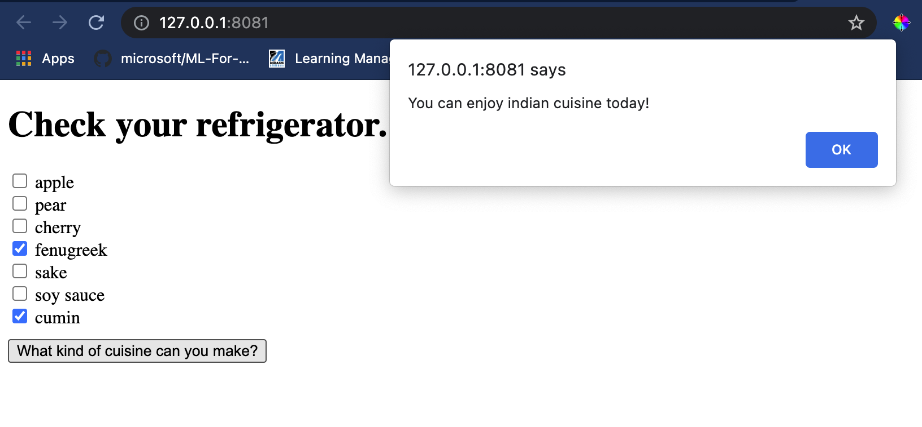
What about Onnx?
The challenge: I work with a data science team and we DON’T use TensorFlow as we don’t use neural networks for our basic classification tasks. Instead, we use Scikit-Learn.
Q: Can I use a Scikit-Learn model to power a web site?
A: Yes, yes you can!

Slide 18

Meet Onnx:
Open Neural Network Exchange
“ONNX is an open format built to represent machine learning models. ONNX defines a common set of operators - the building blocks of machine learning and deep learning models - and a common file format to enable AI developers to use models with a variety of frameworks, tools, runtimes, and compilers”
Tip: you don’t have to leverage NN to use Onnx
“Develop in your preferred framework without worrying about downstream inferencing implications. ONNX enables you to use your preferred framework with your chosen inference engine.”
https://onnx.ai/

Slide 19
The Applied ML workflow
Clean your data
Train your model
Use skl2onnx library to convert your model for use with onnx runtime
Build a basic web app for use with this model
https://onnx.ai/

Slide 20
Step 1 – clean data
Full lesson: https://github.com/microsoft/ML-For-Beginners/tree/main/4-Classification

Slide 21
Step 2 – build model
Full lesson: https://github.com/microsoft/ML-For-Beginners/tree/main/4-Classification

Slide 22
Step 3 – export model
Full lesson: https://github.com/microsoft/ML-For-Beginners/tree/main/4-Classification

Slide 23
Step 4 – use model in web app
Full lesson: https://github.com/microsoft/ML-For-Beginners/tree/main/4-Classification

Slide 24
App demo!
Full lesson: https://github.com/microsoft/ML-For-Beginners/tree/main/4-Classification

